Slide 1



Connext IIITD
Campus events simplified
By
group 2_6

Slide 2

Are you tired of managing emails?
We get atleast 6-7 emails from
various club coordinators each day
It gets really difficult to keep track of each activity organised by our club

Slide 3

TOO MANY EMAILS
EACH DAY
DIFFICULT TO INTEACT WITH
PARTICIPANTS
DIFFICULT TO REGISTER FOR EACH ACTIVITY.
Problem
WE CANT SEE THE REALTIME LEADERBOARD AND RESULTS TAKE TIME TO COME

Slide 4
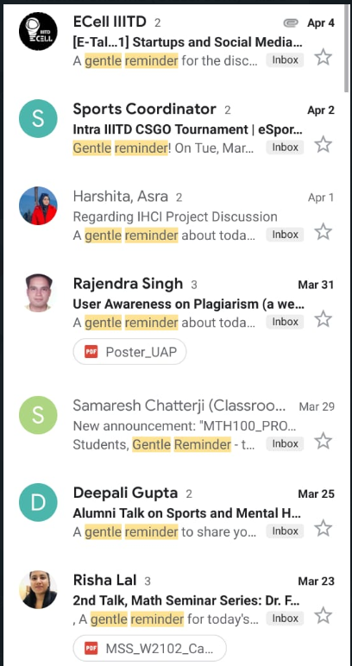
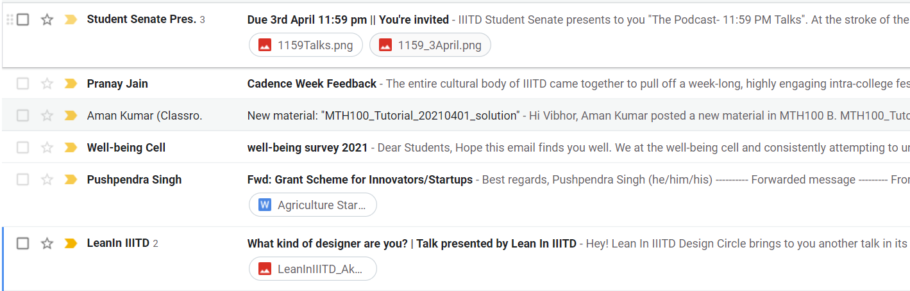
Some Practical Scenarios
Too many unread emails , does it happen with you too frequently ?

Slide 5
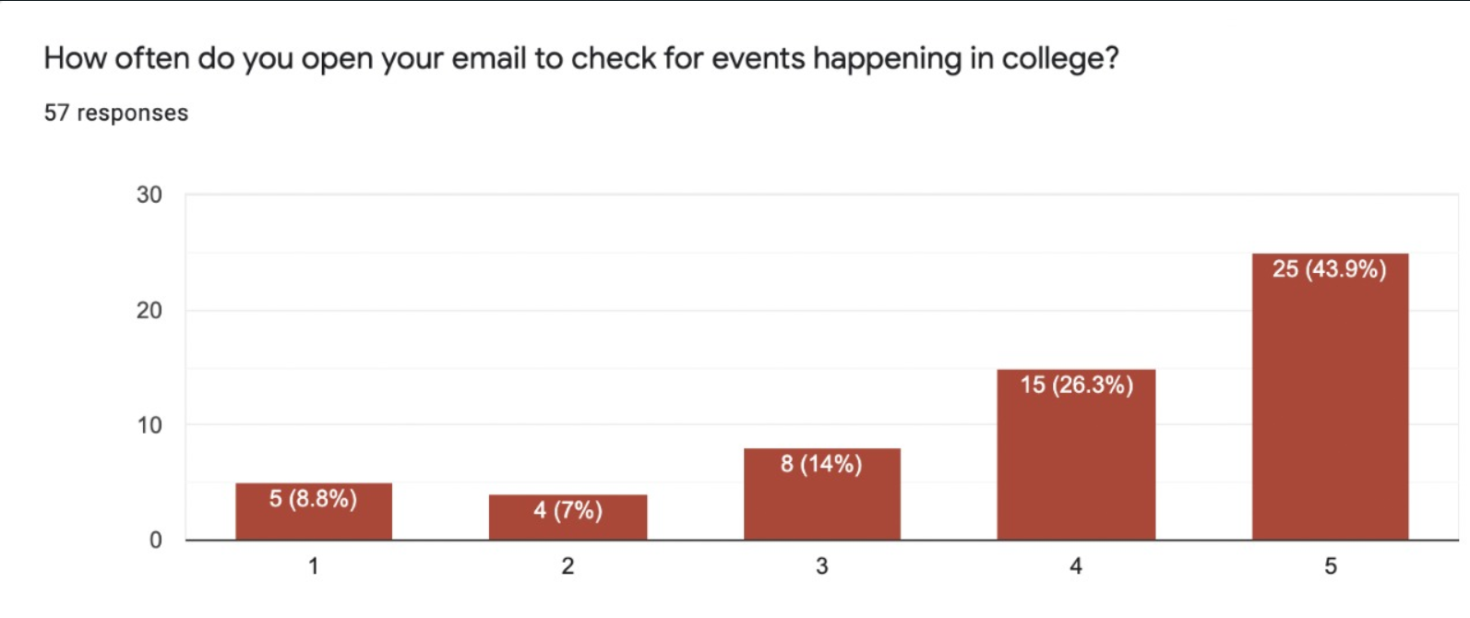
Some Stats

Slide 6
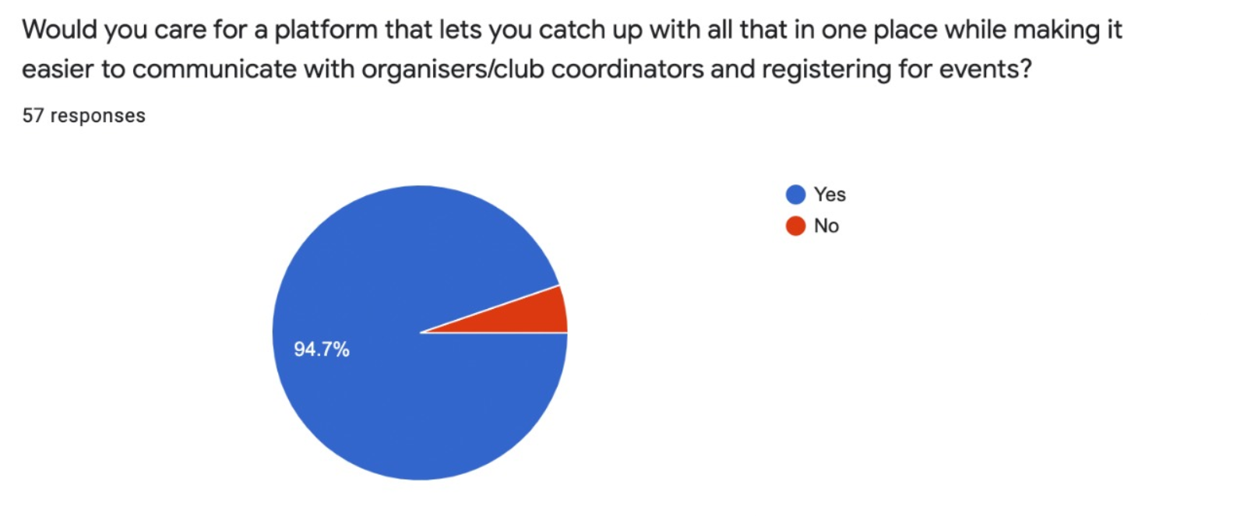
Some Stats-2

Slide 7
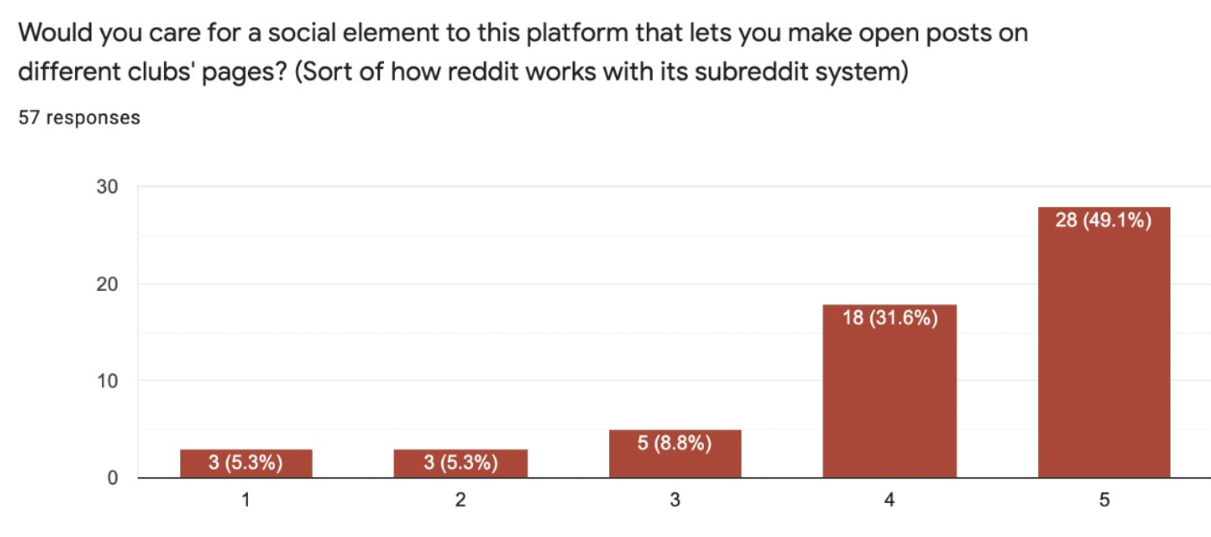
Some Stats-3

Slide 8


We have got you covered
WE PRESENT OUR NEW APP CONNEXT IIITD
IT CAN HELP YOU SEE ALL THE SCHEDULED CLUB ACTIVITIES IN ONE PLACE
YOU CAN REGISTER FOR EACH ACTIVITY SEAMLESSLY AND SEE RESULTS

Slide 9

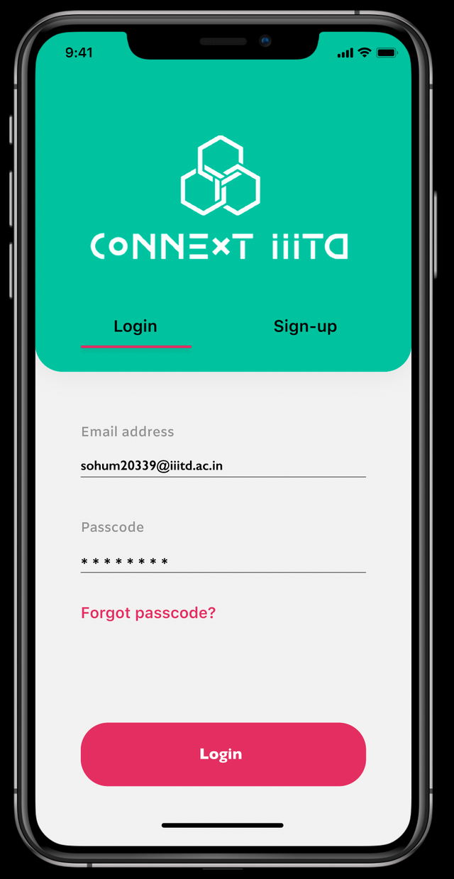
Prototype -1

Slide 10
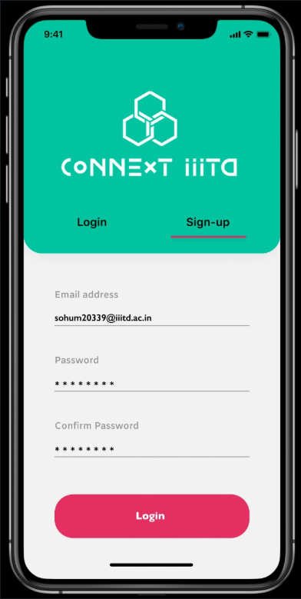
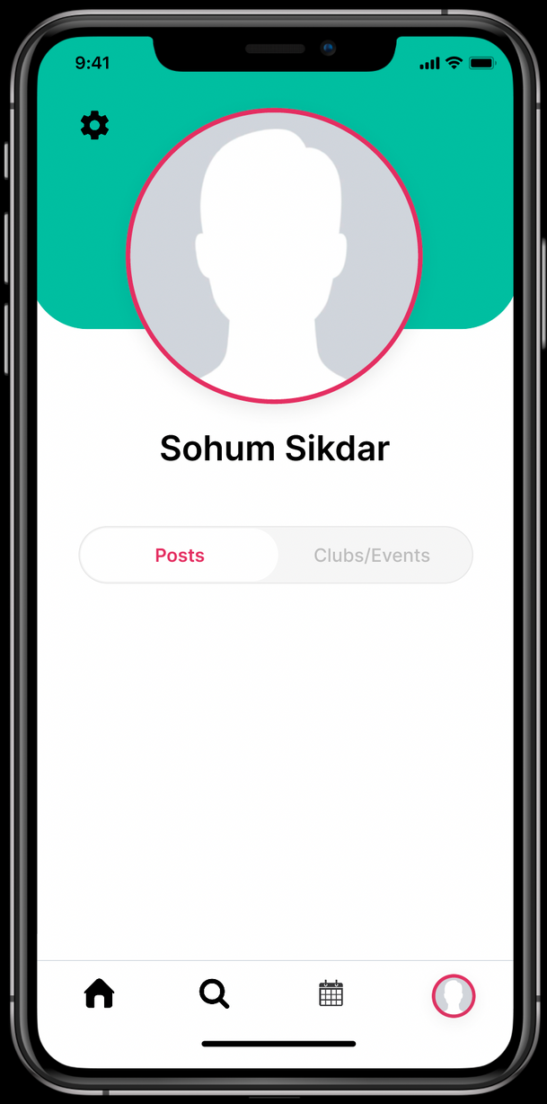
Prototype-2

Slide 11
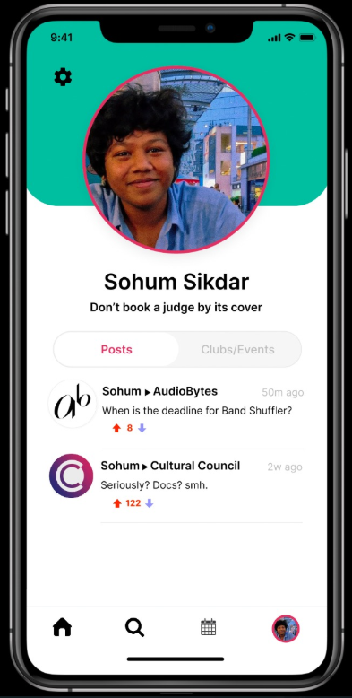
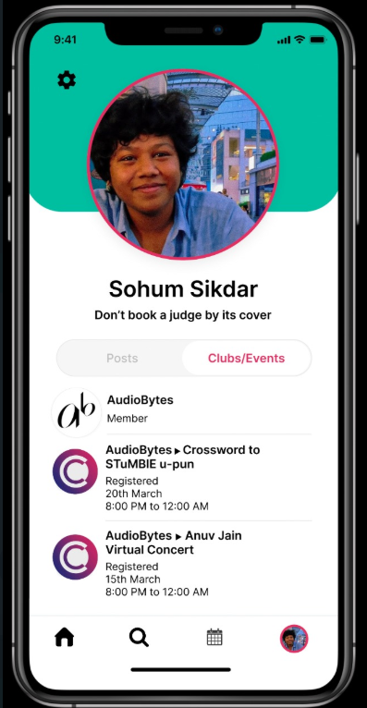
Prototype -3

Slide 12
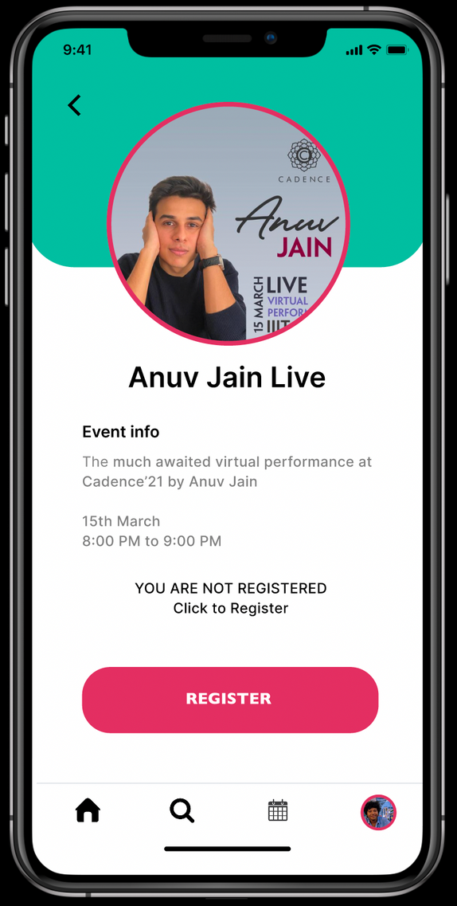
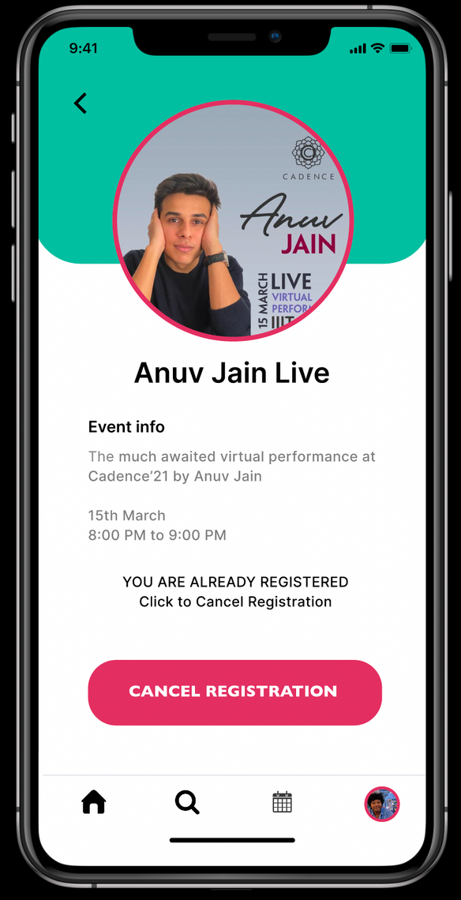
Prototype -4

Slide 13

COMPETITORS
Currently no such app or service is available in our college
OUR PRODUCT
Our product aims to solve the problems we students face daily in communication

Slide 14
USER-1
It would be very useful for me
and make my life a whole lot simpler.
CUSTOMER RESEARCH AND PERCEPTIONS
USER-2
Nice approach , we definitely need this app in our college
USER -3
Great idea, why did not we think this before. Launch it soon

Slide 15
PLACE ADVERTISEMENT
WHERE APPROPRIATE
USE A PART OF THE RESPECTIVE CLUBS FUNDING WHO WISH
TO USE THE APP
COLLABORATION WITH
SOME LESSER KNOWN ARTISTS TO PROVIDE THEM THE PLATFORM TO SHOW THEIR TALENT
AND CHARGING SMALL COMMISSION FOR THAT
Revenue Model

Slide 16
Customer Feedback
We will have a dedicated section where users can give feedback about existing features
Users can also make polls about
new features they want and we
will try to implement them
if possible

Slide 17
NO MORE EMAIL
HASSLE
SEAMLESS WAY TO REGISTER AND PARTICIPATE IN CLUB ACTIVITIES
AND SEE RESULTS
Benefits and highlights
EASY CONTACT WITH PEERS AND SEE LEADERBOARD

Slide 18
The Team
group 2_6
VIBHOR
AGARWAL
SOHUM
SIKDAR
SOURAV
GOYAL
AKANSHAK
SINGHAL
SHIVANSHU
PANDEY

